Slide 1



Day 33
contact@anubhavtrainings.com
ABAP RESTFUL APPLICATION PROGRAMMING

Slide 2

Agenda – Day 33
Understand the persona for Approver
Implementing Approver projection
Annotations for Approver Scenario
Behavior Definition for Approver
Service Binding for Approver Scenario
Fiori App for Approver
Deploy Fiori App to SAP CF

Slide 3

Understand the Persona for Approver
The business object projection is the basis for a UI service that contains the functionality that is relevant for an approver. Imagine a person, maybe a manager of a travel agency, that approves the data that was entered by the processor. That means, this person sees the travel information and the corresponding booking data. Based on this data, the approver can either accept or reject the travel. For a minimal scope of fields in the travel entity the approver is enabled to edit the values, for example the BookingFee or the Description. The information about bookings is set to read-only for the approver. The approver is not allowed to change the fields of the booking entity.
Approver
Accept
Reject

Slide 4
Approver Scenario
Travel Projection CDS View for Approver BO
Except for the actions, which are different in the processor and the approver projection, the CDS projection views for the processor and the approver BO are identical. Minor changes can be detected in the field label of the field TravelID and TravelStatus. This results from the fact, that the approver does not create new travel entries. It is not necessary for this role to know the number range of the TravelID or the possible values of the TravelStatus. In addition, the approver BO projection has gained a selection field for the TravelStatus to make it easier for the approver to filter for open/accepted/rejected travels.
Actions
The position and the label for the action button must be defined in the CDS projection views. In the case of an approver, the available actions concerning the travel entity set are Accept Travel and Reject Travel. The implementation of these actions is done in the behavior implementation . It is simply the UI appearance that needs to be configured in the projection view. The action buttons for the respective actions are designed to appear on the travel list report page and on the travel object page. That is why the annotations are used in the list item and identification UI annotation. When executing the action on the list report page, a travel instance must be selected to assign an instance for the instance-bound action. On the object page, the instance for which the action shall be executed is clear.
Booking Projection CDS View for Approver BO
The CDS projection views for the processor and the approver BO are almost identical.
Value helps are not necessary for the interpretation of the approver role in this scenario. As the booking entity is a read-only entity in this scenario and selection fields with value helps cannot be defined for a sub entity, value helps cannot be applied and thus are not necessary to be defined for the booking entity.

Slide 5
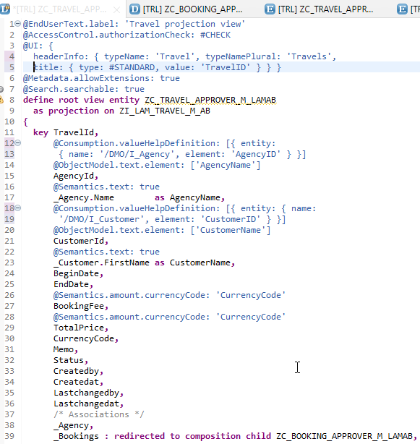
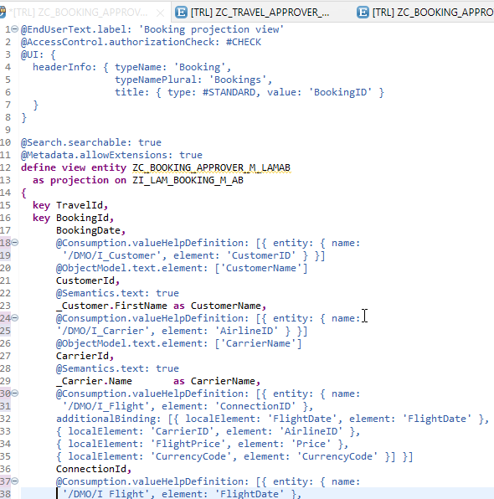
Implementing Approver Projection CDS
ZC_TRAVEL_APPROVER_M_LAMAB
ZC_BOOKING_APPROVER_M_LAMAB

Slide 6
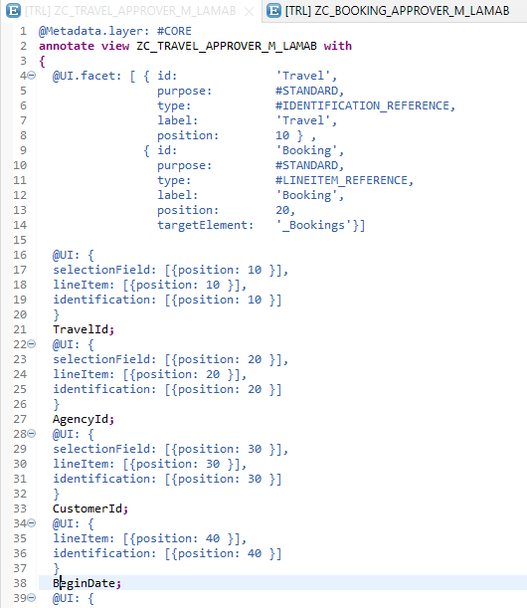
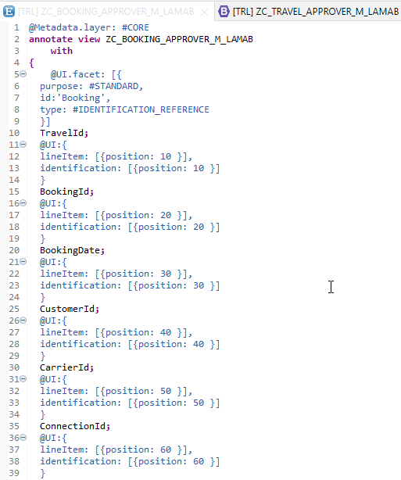
Metadata Extension
Metadata Extension for Travel
Metadata Extension for Booking

Slide 7
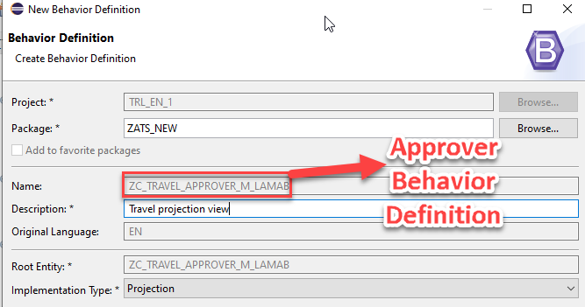
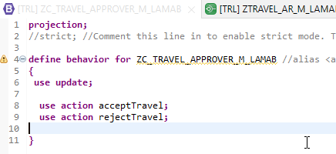
Behavior Definition for Approver
The scope of the UI service for the approver is more limited than for the processor. The approver can only modify the travel entity with accepting or rejecting the travel entries. The values in the corresponding booking entries are the basis for this decision-making.
The behavior for the BO projection is defined in a behavior definition of type projection. The type is defined in the behavior definition header. The projection behavior definition provides the behavior for the projection CDS view. All characteristics and operations that you want to include in the BO projection must be listed explicitly. The keyword for this is use. - Code here

Slide 8
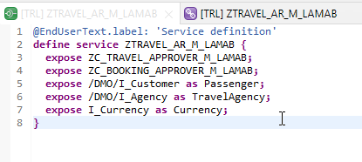
Service Definition
The service definition is a projection of the models and related behavior that you want to expose.
In a service definition, you define the OData service to determine which CDS entities are part of the service. This service is then bound to a protocol and to either a UI technology or an A2X service by a service binding artifact. A service definition can be integrated in various protocols without any reimplementation.
Service definition is used to assign the scope of the OData service. Travel, Booking, Passenger, TravelAgency, Currency CDS views are exposed in the service definition. Optionally, you can assign an alias for the each exposed CDS view
Exercise
Service Definition

Slide 9
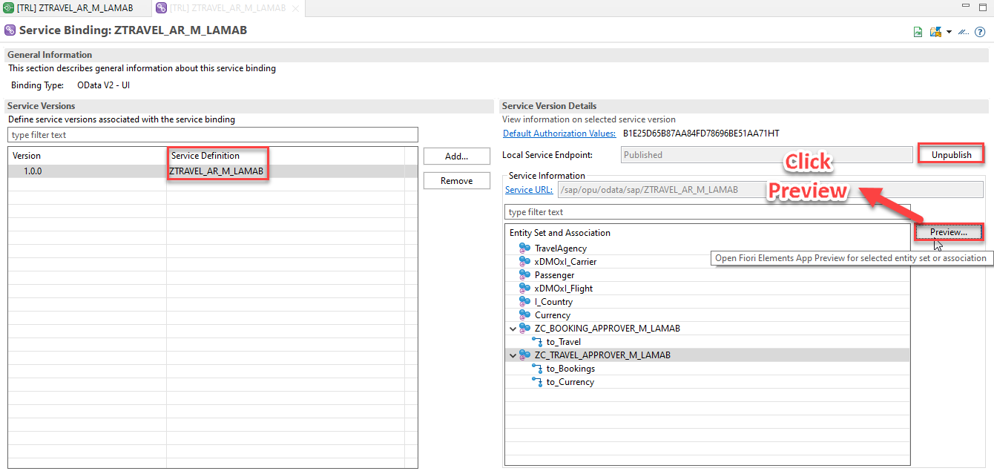
Service Binding
A service binding implements the protocol that is used for the OData service. It uses a service definition that projects the data models and their related behaviors to the service.

Slide 10
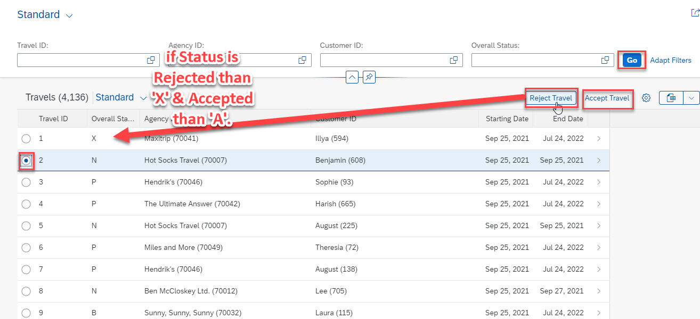
Fiori App Preview

Slide 11
Deploy Fiori App to SAP CF

Slide 12

End of Day 33
Trainer: Anubhav Oberoy

Slide 13

Trainer: Anubhav Oberoy

Slide 14
THANK YOU
If you cannot do
great things, do small things in a great way.
Anubhav Oberoy
https://www.anubhavtrainings.com

Slide 15


We’re committed to empower you to be
Most Desirable Resource
through powerful training solutions.
We build the workforce of the future.
250+
Corporate Clients
30,000+
Learners Trained
25000+
Learners Placed
FREE WEBINARS
Sign up for free webinars with industry experts every fortnight!
Enroll Now!
Contact us today!
https://anubhavtrainings.com/

Slide 16




More from AnubhavTrainings.com

